Slide 1

Machine Learning for Biomedical Engineering Applications
Week 3
Maral Aminpour, Ph.D.Professor Department of Biomedical Engineering

Slide 2
Regression

Slide 3
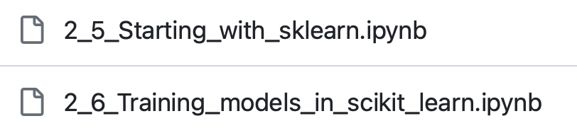
Part I: Linear Regression (Sklearn)
Notebooks
Notes:
We will start with mathematical formulation and fitting of the linear regression model.

Slide 4
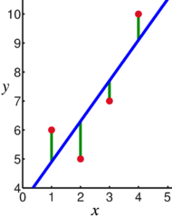
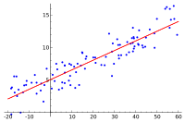
Linear Regression
Regression problems we are predicting a numerical quantity (unlike with classification where we are predicting a nominal label).
The simplest form of regression is linear regression (also known as the least squares method).
This is a problem from calculus that tries to find a line that minimizes the squared distance from a collection of points.

Slide 5


Predicting house prices: A case study in regression
One classic example that's super useful for understanding regression and it is usually used to teach is house pricing.
Suggested videos and tutorials about predicting house prices
Simple Linear Regression by Emily Fox (16 minutes)
check this video about gouse porice prediction and linear regression [here ](https://youtu.be/xsTmUtwUg9Q)
check the related tutorial by Smith White (https://colab.research.google.com/github/ualberta-rcg/python-machine-learning/blob/main/notebooks/02-regression.ipynb).
Notes:
One classic example that's super useful for understanding regression and it is usually used to teach is house pricing. In this context, the **"intelligence" we're seeking to derive is the potential value of a house that's not currently on the market.** Our goal is to estimate this unknown value using data.
**sale prices as a basis to infer the potential value of our target house**.
Look at various characteristics of these houses, such as the number of bedrooms, bathrooms, and the total square footage, among other things.
Our machine learning strategy will be to establish a relationship between these house features and their sale prices.

Slide 6

Scikit-learn
A Python library of machine learning algorithms
Consistent application interface (API)
Four types of objects implement the machine learning tasks we learned
regressor
classifier
clusterer
transformer
Each type of object has prescribed methods it needs to implement
fit – fit model 𝑓 to features 𝑿 [and outputs 𝒚 for regressors and classifiers]
predict – apply fitted model 𝑓 to a feature matrix 𝑿 to predict outputs 𝒚ෝ for regressors, classifiers and clusterers
score – evaluation metric for regressors and classifiers
transform – apply feature transformation for transformers
fit_transform – fit the model and apply feature transformation for transformers

Slide 7
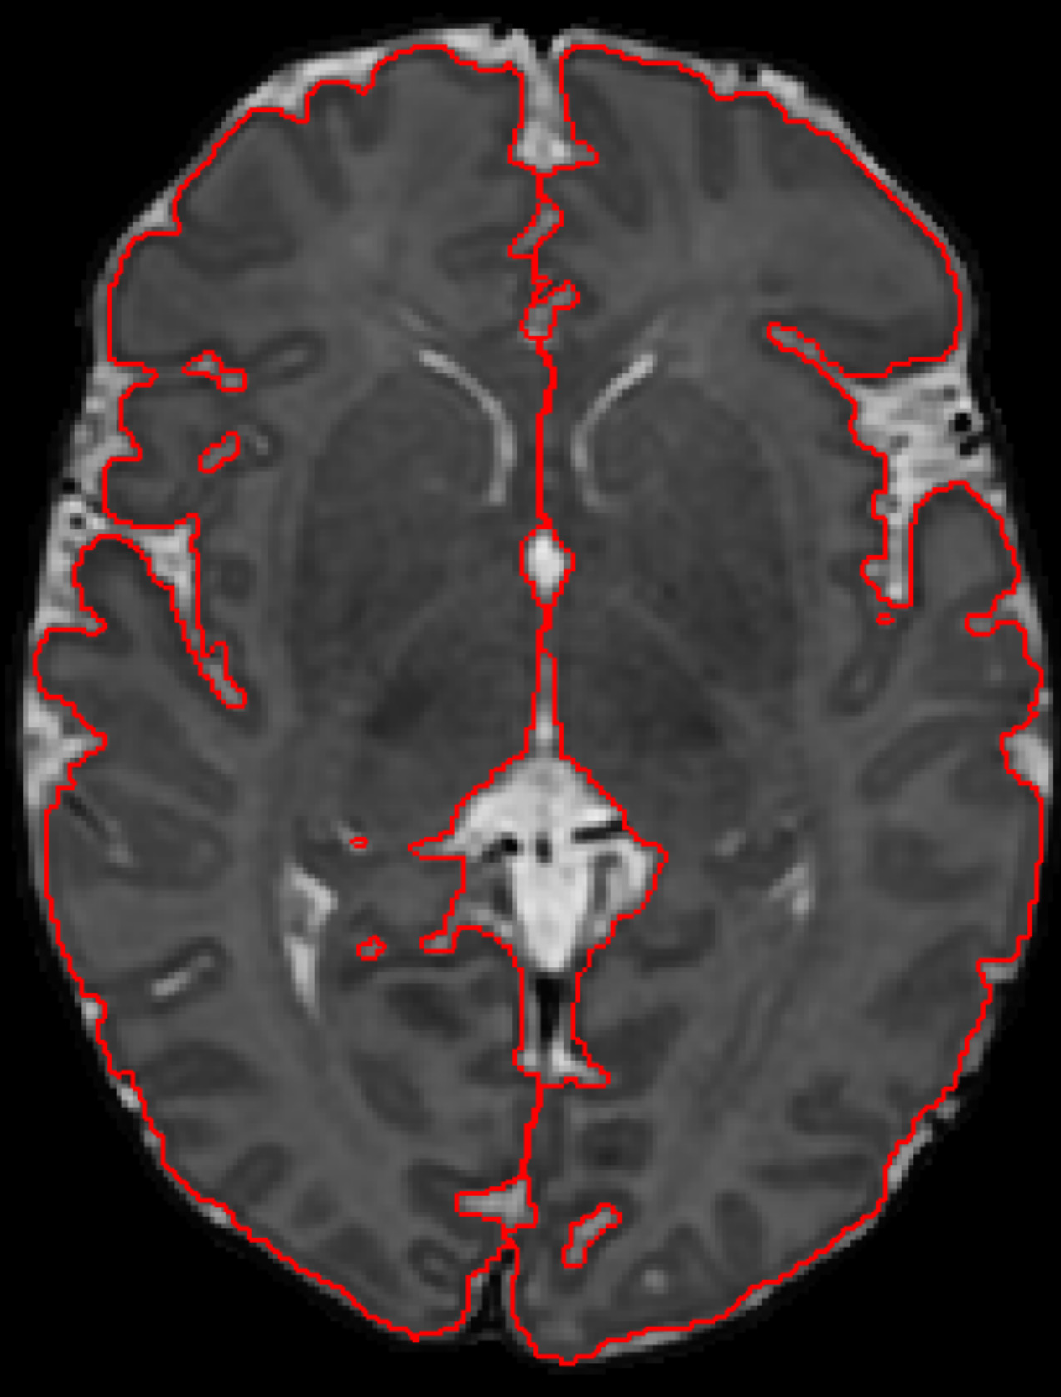
Predict the brain volumes from GA
The file 'neonatal_brain_volumes.csv' contains gestational ages (GA) and brain volumes of premature babies.
We will fit a LinearRegression model to predict the brain volumes from GA. This is an example of a regression problem.
The data we'll be using has the brain volumes already computed.
gestational ages
(GA): The gestational age of a baby refers to the length of time a baby has been developing in the uterus, starting from the first day of the mother's last menstrual period to the current date. It is measured in weeks and days.
Notes:
The image on the right is an example of a scan that could be used to estimate brain volumes; however the data we'll be using has the brain volumes already computed.

Slide 8
Outline
Data Expletory
Create Model
Fit Data (Train data)
Evaluate the Model
Predict on New Data
Plot with Matplotlib

Slide 9
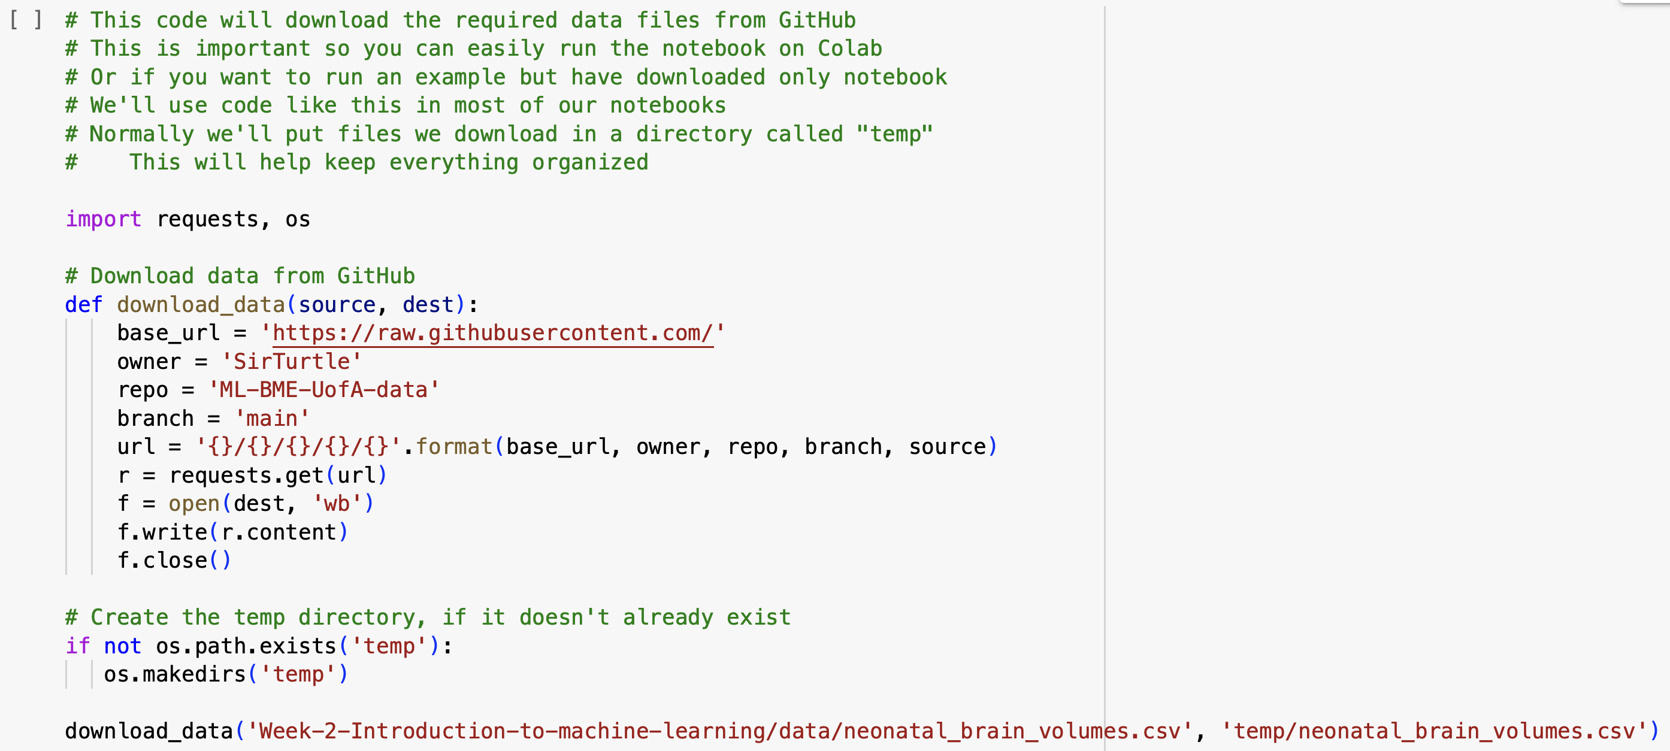
Download the data

Slide 10

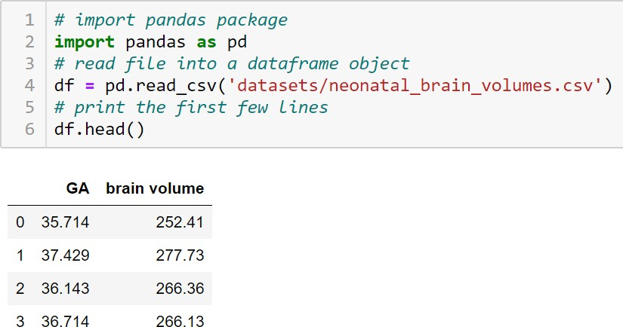
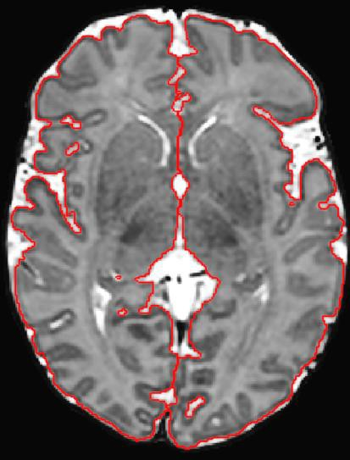
Load data using Pandas
Pandas
Extensive functionality for manipulating tabular data
Imports Excell, CSV and pickle files
Example: neonatal brain volumes
Notes:
First we will import the data file using the pandas package and check its content.

Slide 11

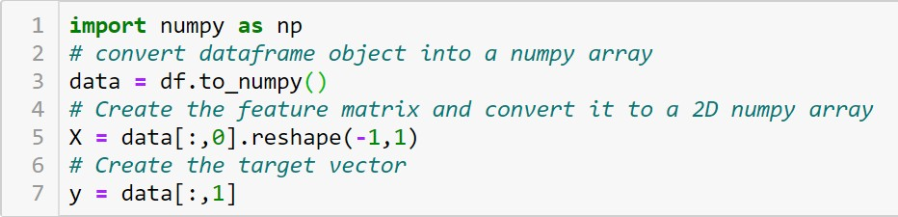
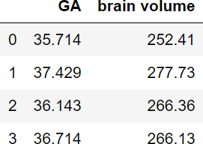
Prepare the data
Create feature matrix 𝑿 and target vector 𝒚
We will convert to Numpy arrays
𝑿
𝒚
Notes:
sklearn objects require 2D feature matrices, here achieved by reshape function
sklearn objects can work with Pandas dataframe objects too
GA: gestational age (in weeks)
brain volume: measured brain volume (in mL)
Notes:
Tip: It is a very good practice to create a data dictionary that describes the structure of your data. The data dictionary will have text about each column. It is useful to include info such as units and acceptable values when possible.

Slide 12
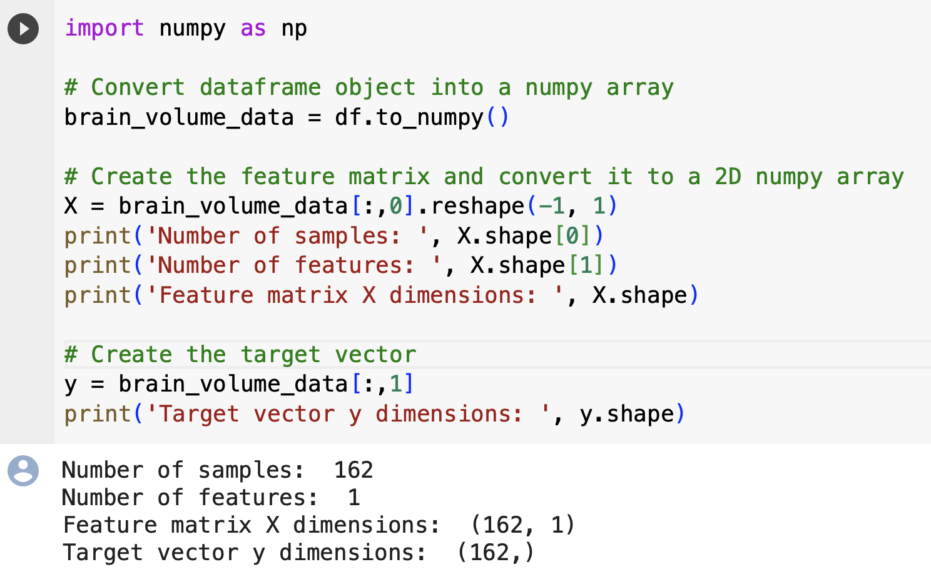
Print number of samples, number of features, …
Notes:
Note that in the example our feature matrix for each data sample is only dimension N x 1 since we have only a single feature. But generally, there will be multiple features for each sample.
We've selected brain volume as the target that we'll build our model to predict,
but we could have done the reverse and built a model to predict GA from brain volume.

Slide 13

Note about reshape (-1,1)
Note about reshape (-1,1): In the context of programming and data science, reshape(-1, 1) is often used to change the shape of an array or a data series into a column vector.
reshape: It is a function/method used to give a new shape to an array without changing its data. This is a method used to change the shape of your array (the way your data is structured in rows and columns).
-1: This value is used to automatically calculate the number of rows that is necessary. Essentially, it means "unspecified": the number of rows will be automatically calculated to maintain the number of elements in the array.
1: This value specifies that we want one column. This indicates that we want each element in the array to be contained within its own array - essentially turning the array into a column vector with one element per row.

Slide 14
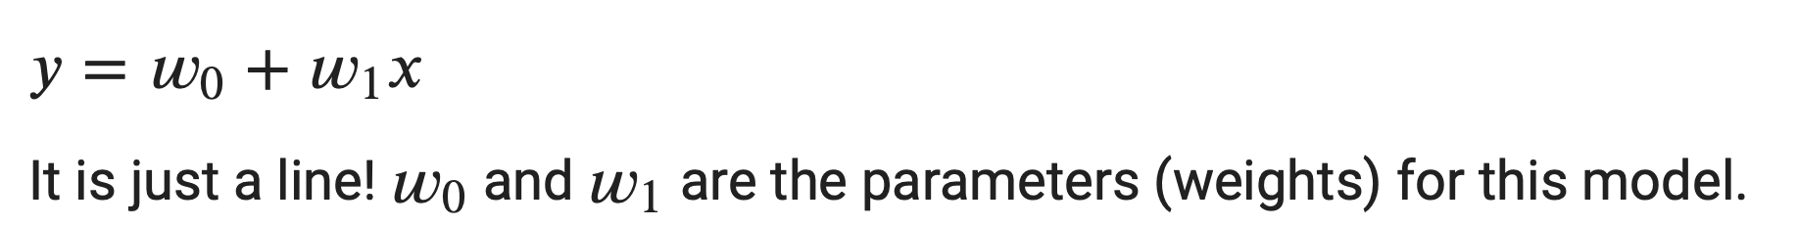
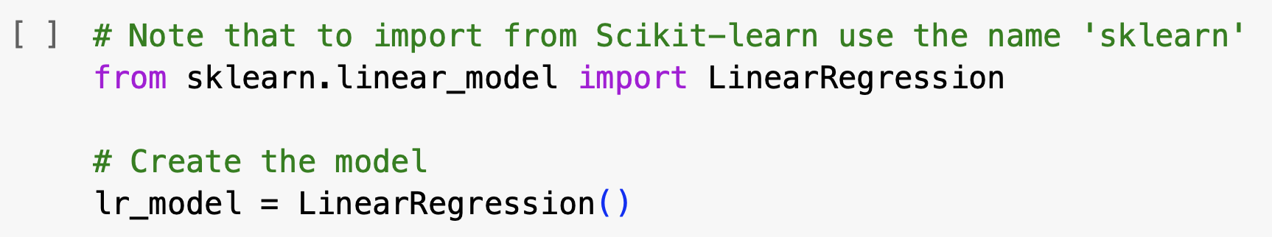
Create the model
Now we select and create the [linear regression model. A linear regression model with one feature (univariate) has this functional form:
The object we instantiate will be an untrained linear regression model that we can train on any type of data.
Notes:
Now we select and create the [linear regression model. A linear regression model with one feature (univariate) has this functional form:
$y=w_0+w_1x$
It is just a line! $w_0$ and $w_1$ are the parameters (weights) for this model.
**The object we instantiate will be an untrained linear regression model that we can train on any type of data.**

Slide 15
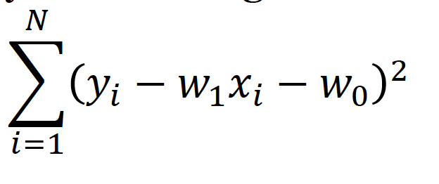
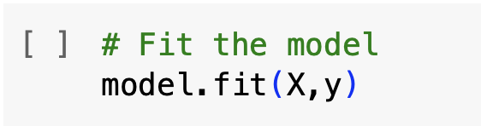
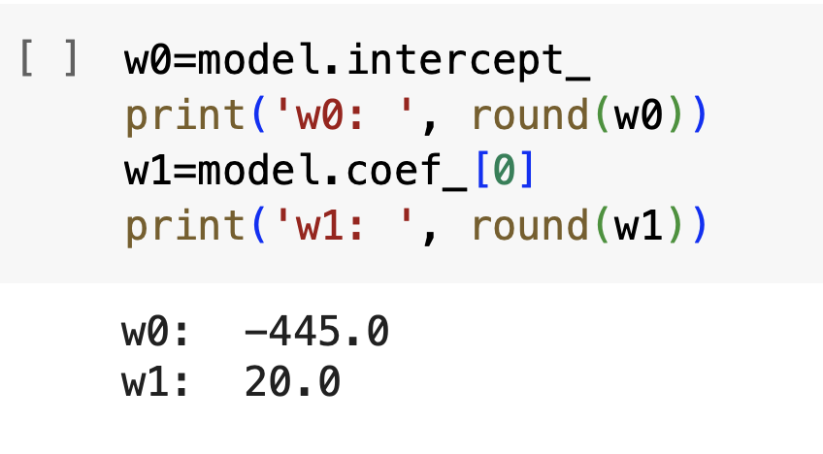
Fit the linear regression model
Univariate linear regression model:
Find parameters 𝑤₀ and 𝑤₁ by minimising
X is a set of input features (X) and corresponding output labels (y).
X: This is generally a two-dimensional array or a pandas dataframe where each row represents a distinct data point and each column represents a different feature. Essentially, it contains the independent variables that are used to predict the target variable (y).
y: This is generally a one-dimensional array or a pandas series that contains the target variable or output labels that we are trying to predict.
Notes:
**lr_model.fit(X, y)** is a command to train a linear regression model (denoted here as lr_model) using a **set of input features (X)** and corresponding **output labels (y)**.
**X: **This is generally a two-dimensional array or a **pandas dataframe** where **each row represents a distinct data point** and **each column represents a different feature**. Essentially, it contains the independent variables that are used to predict the target variable (y).
**y:** This is generally a **one-dimensional array or a pandas series** that **contains the target variable or output labels** that we are trying to predict. The y array has as many elements as **there are rows in the X array, with each element of y corresponding to a row in X.**
When you run **lr_model.fit(X, y)**, the algorithm will learn the relationship between **X and y** during the training process, by finding the best-fit parameters that minimize the error between the actual and predicted values of **y**.

Slide 16
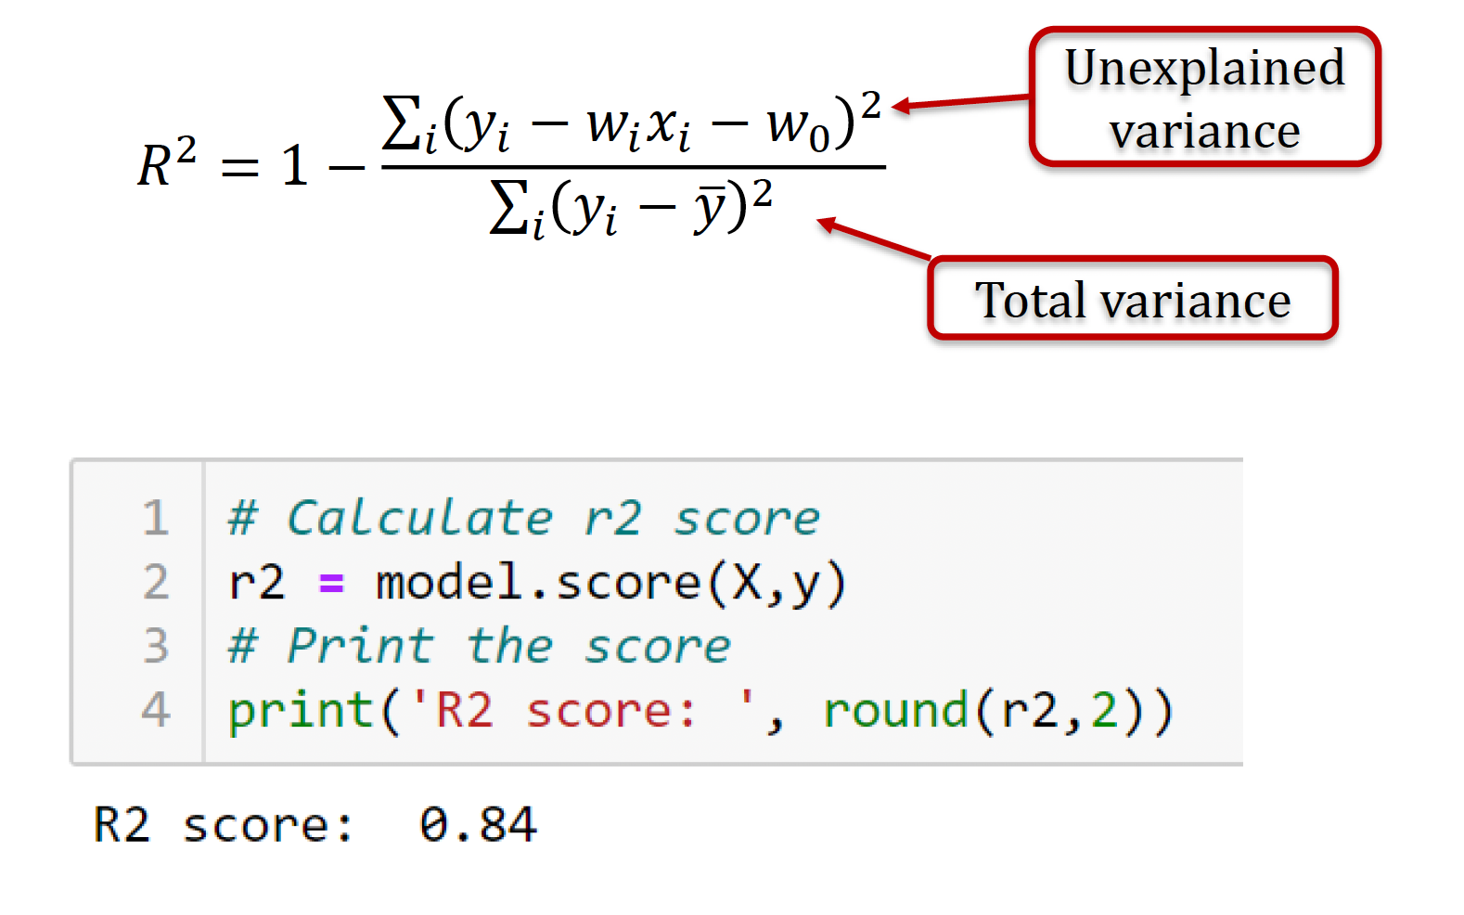
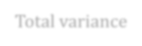

Evaluate the model
R² score
the default measure to evaluate regression models in sklearn
Proportion of total variance in the data explained by the model
Perfect fit results in 𝑅² = 1
Total variance
How good is this score?
Keep in mind that a high R-squared doesn't guarantee your model is perfect; it's just one indicator of how well it's doing.
A score close to 1 means your model does an excellent job at explaining the variation in the data, while a low score suggests there's room for improvement.
Notes:
The model can be evaluated by calling the function score. For regressors this function returns the 𝑅2 score.
How good is this score? 1 is perfect (the best score). So 0.84 is a decent score.
**Note**: The R-squared score in regression is like a **report card for your model**. **It measures how well the model's predictions match the actual data.** The score ranges from 0 to 1. A score close to 1 means your model does an **excellent job at explaining the variation in the data**, while a low score suggests **there's room for improvement**.
**Keep in mind** that a high R-squared doesn't guarantee your model is perfect; it's just one indicator of how well it's doing.

Slide 17

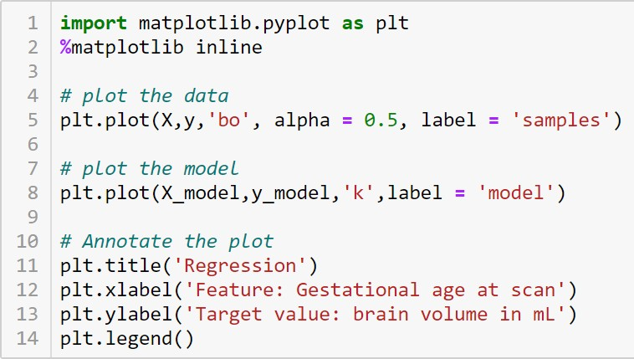
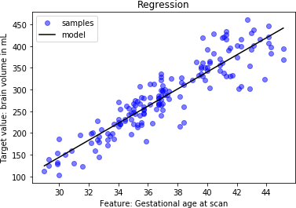
Plot the result with Matplotlib
Matplotlib
Python library for visualisation
Similar to Matlab
%matplotlib inline
plots appear and are stored in Jupyter notebooks
Note: When the data points are closely packed around the line produced by the linear model, it's a visual indication that the model is a good fit for the data. In technical terms, a high 𝑅2 score would mean that a large percentage of the variance in the target variable (in this case, brain volume in mL) can be explained by the feature (Gestational age at scan).
knowing the gestational age allows us to make very good predictions about the brain volume.
Notes:
Note that the points mostly lie near the line defined by the linear model. This is a visual representation of the 𝑅2 score.
Note: When the data points are closely packed around the line produced by the linear model, it's a visual indication that the model is a good fit for the data. In technical terms, a high 𝑅2 score would mean that a large percentage of the variance in the target variable (in this case, brain volume in mL) can be explained by the feature (Gestational age at scan).
So, when you look at the plot and see the points hugging the line, you can be pretty confident that your 𝑅2 score is going to be high, indicating a good model fit.
In other words, when we say "a high 𝑅² score means a large percentage of the variance in brain volume can be explained by the gestational age," we mean that a high 𝑅² score indicates that knowing the gestational age allows us to make very good predictions about the brain volume. It means the gestational age has a strong relationship with the brain volume, and we can use it to estimate the brain volume quite accurately, with a good deal of confidence.

Slide 18
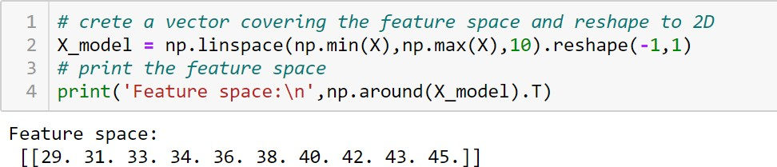
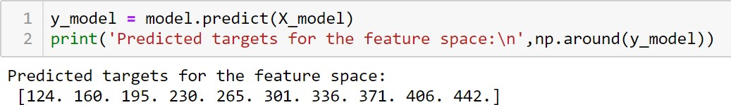
Predict on new data
Once model has been fitted it can by evaluated on new samples
Let’s cover the feature space (GA 29-45 weeks) to plot the model
Predicted target values can be obtained using function predict
Notes:
When we're using machine learning to make predictions about continuous outcomes, it's really useful to see how well our model is doing by checking (plotting) it against the actual data visually. To do this, we check out the 'feature space,' which is just a fancy term for looking at all the possible values our features can have — in this scenario, it's different gestational ages (GA).
extra
Here, we create a grid of 10 evenly-spaced points that cover the smallest to the largest GA values in our dataset using NumPy's linspace function. This grid allows us to make predictions at various points, giving us a nice, smooth curve when we plot the data and the model together.
The .reshape(-1, 1) part is making sure that the shape of X_model is a column vector (2D array), which is often required by machine learning models. 1D arrays are just one row of values, while 2D arrays contain a grid of values that has several rows/columns.
And yep, even though we're dealing with only one feature (GA), we still need a 2D array because most machine learning functions are designed to handle multiple features. So, that's why we reshape the array to make it a column vector.
Finally, print('Feature space:\n', np.around(X_model).T) is printing out the transposed version of this new feature space, after rounding each value to the nearest integer.

Slide 19

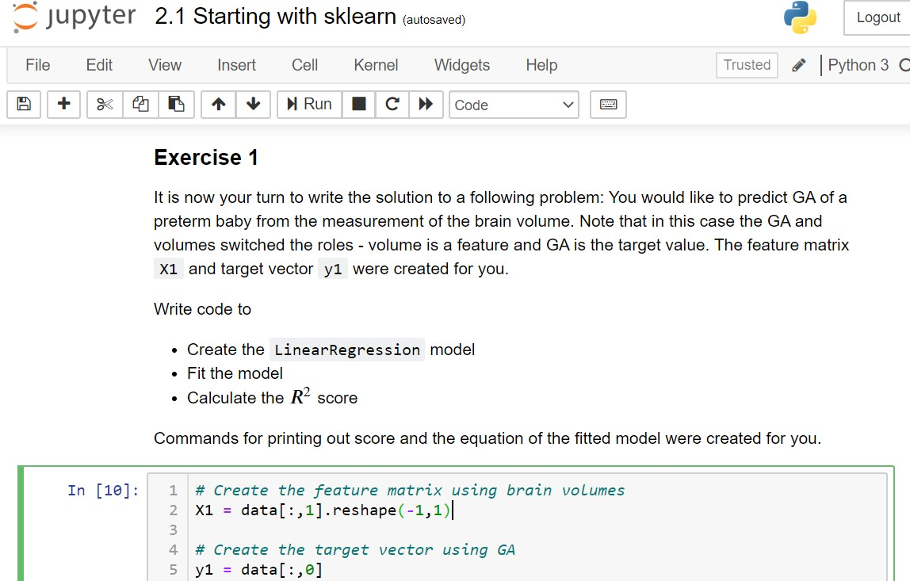
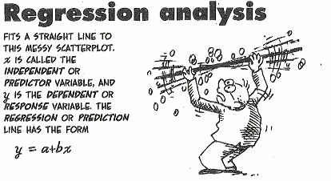
Exercise 1: Test your knowledge
Test your knowledge
2_5_Starting_with_sklearn.ipynb

Slide 20
Part II: Training Machine Learning Models
Notebooks
Notes:
We will start with mathematical formulation and fitting of the linear regression model.

Slide 21
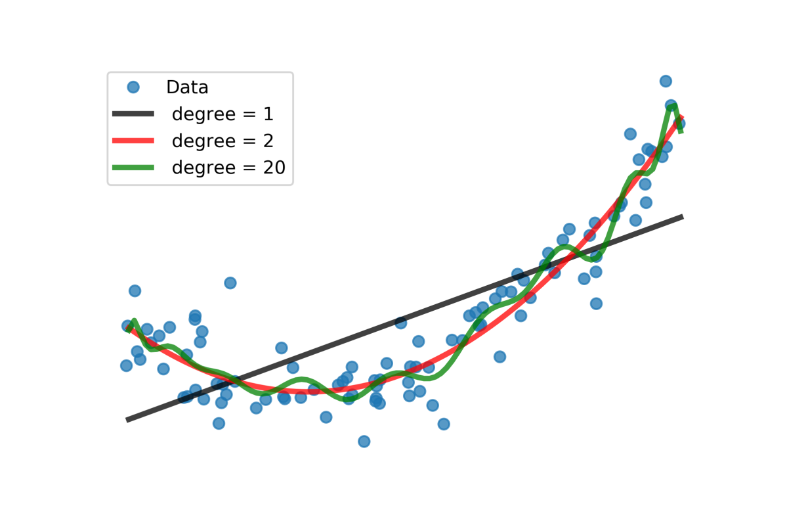
Training machine learning models
We know how to create, fit, and evaluate machine learning models.
Question: How to choose the best model for our data?
Example:
Noisy data from an unknown polynomial model
Can we recover the underlying polynomial model?
Which polynomial degree we choose?

Slide 22
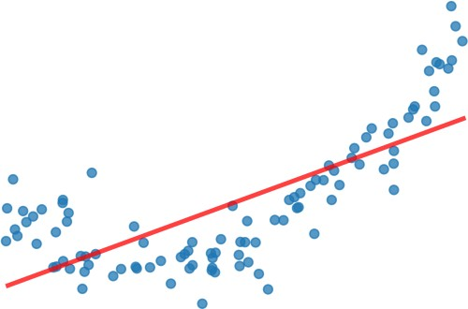
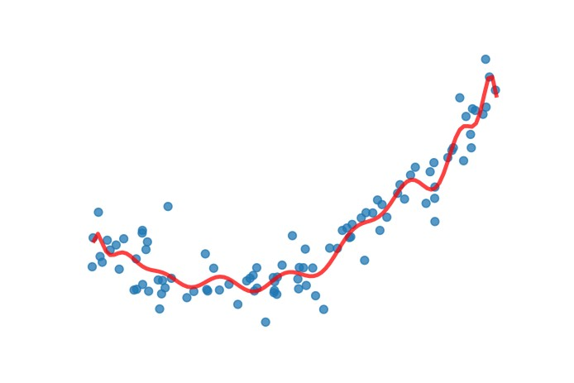
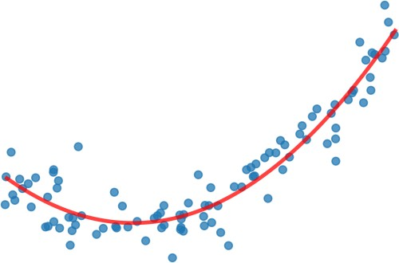
Underfitting and overfitting
Underfitting:
model misses important trends in the data
systematic errors in predictions (bias)
too few parameters to be fitted in the model
Overfitting:
model does not generalise well to unseen data
model is driven by the noise in the data
too many parameters to be fitted in the model
Just right:
no systematic errors
generalises to new data
right number of parameters to be fitted in the model

Slide 23
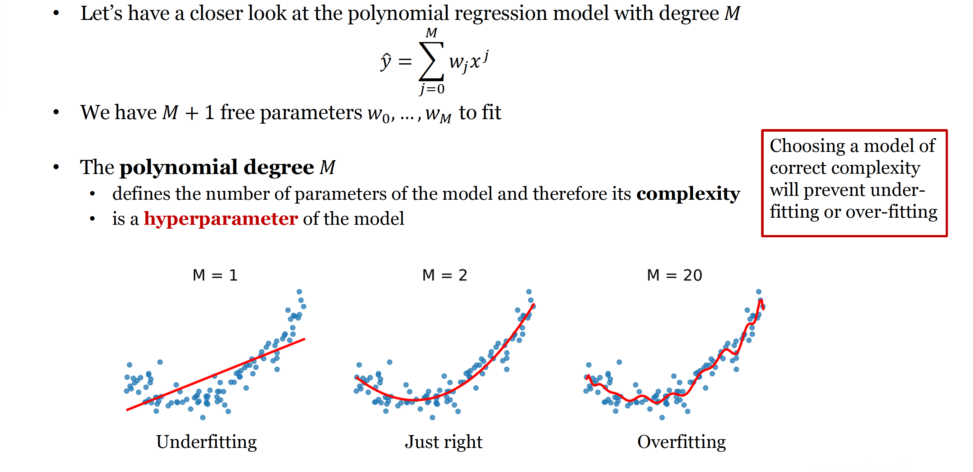
Polynomial regression

Slide 24
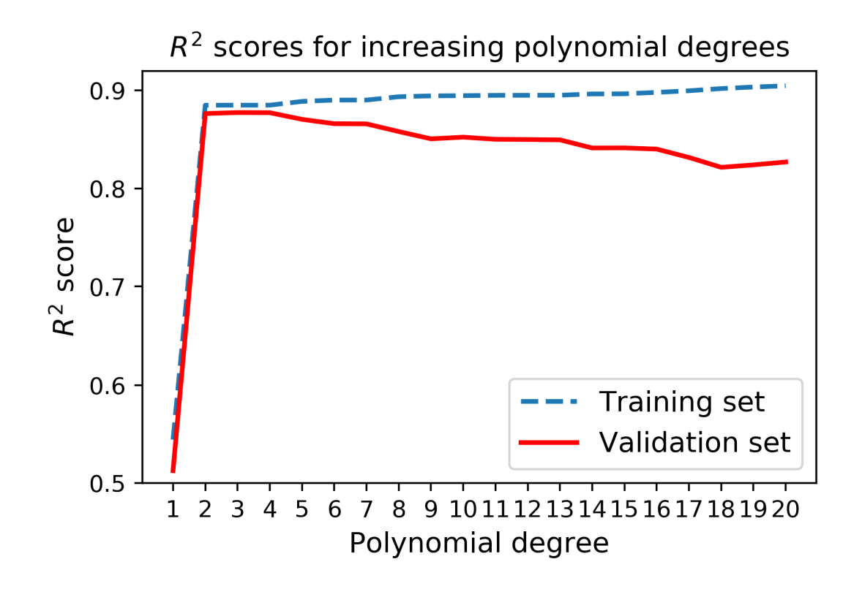
Training, validation and testing
How to choose the right model quantitatively?
Let’s evaluate 𝑅² score for different polynomial degrees 𝑀
Training set: samples used for fitting of the model
𝑅² score on training set
increases with the polynomial degree 𝑀
we cannot identify overfitting
Validation set: samples not used for fitting
𝑅² score on validation set
highest for polynomial degree 𝑀 = 2
we can identify optimal hyperparameters
Test set: samples not used for fitting/validation
𝑅² score on test set
to evaluate performance: 𝑅² = 0.88

Slide 25
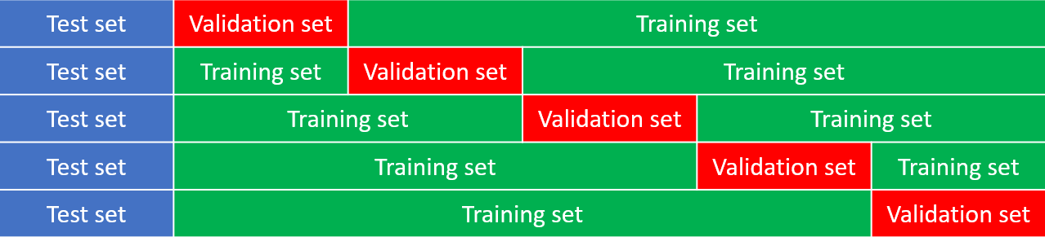
Cross-validation
We would like to avoid excluding 2 sets of data from training
Cross-validation
We exclude the test set at the beginning as before
Split remaining data into 𝑘 equal groups (folds)
Train the model 𝑘 times on 𝑘 − 1 groups and validate on the remaining group
Choose the hyperparameters with best average performance over the 𝑘 validation sets
5-fold cross-validation

Slide 26
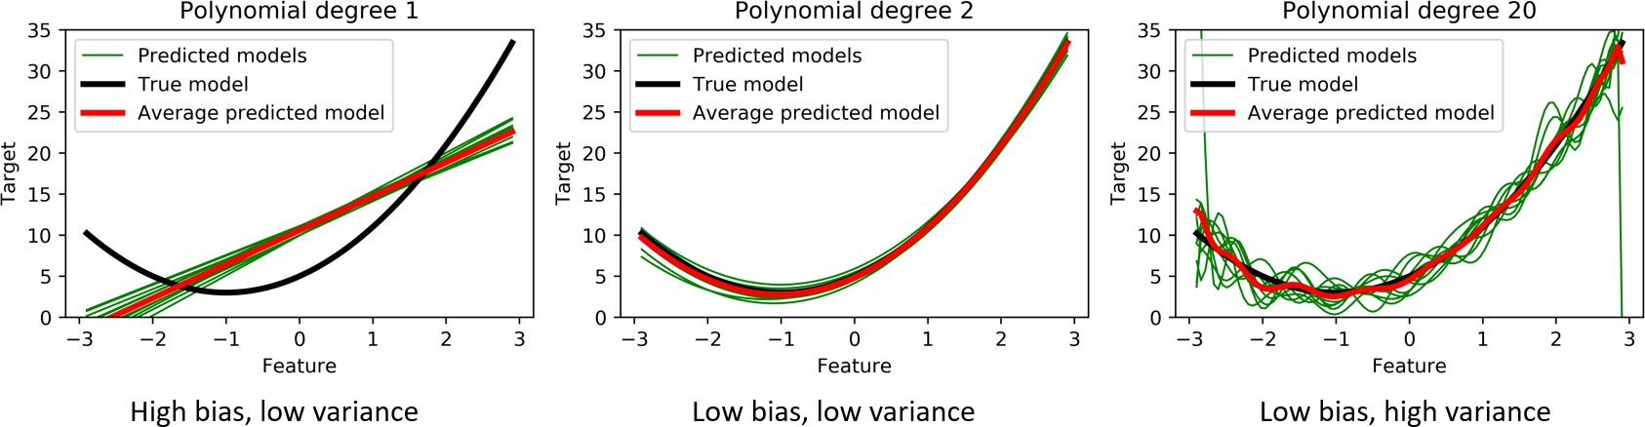
Bias and variance
The fitted models will vary if we use different training samples
By comparing these models, we can recognise tree types of error
Bias: error between average predicted values and the true model
Variance: variance of the values predicted by different models
Noise: error between sample target values and the true model

Slide 27
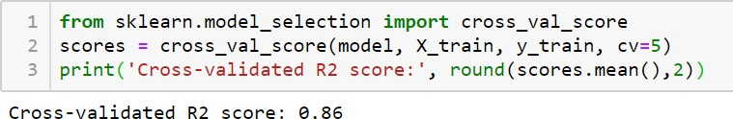
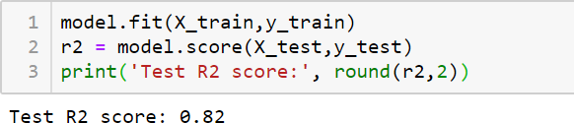
Training, validation and testing in scikit-learn
Split the data into training set and test set (typically 80:20)
Calculate performance of a model using 5-fold cross-validation
Calculate performance on test set

Slide 28
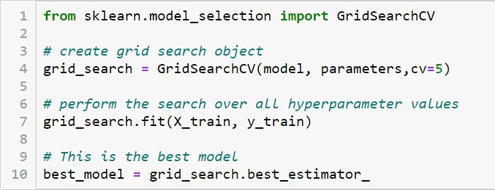
Hyperparameter search using cross-validation
Scikit-learn function GridSearchCV
performs cross-validation for all hyperparameters given in parameters
returns the model with best performance in best_estimator_

Slide 29
Part III: Polynomial regression
Notebooks
Notes:
We will start with mathematical formulation and fitting of the linear regression model.

Slide 30
Training models in Scikit-Learn (polynomial regression)
Split the data into training set and test set
Fit a polynomial model to the training data
Set up a pipeline to automate processing and fitting
Use cross-validation
Use grid search to optimize the polynomial degree hyperparameter
Evaluate performance on the test set

Slide 31
Generate the dataset (simulated dataset)
We will generate the training data from a quadratic model 𝑦=2𝑥2+4𝑥+5
by generating random features from uniform distribution for the interval [−3,3]
using rng = np.random.default_rng() and rng.random and adding Gaussian noise with 𝜎=3 to the target values using rng.standard_normal.
Run the code below to generate your dataset. Note that
Feature matrix is given in the variable X
Target vector is given in variable y

Slide 32
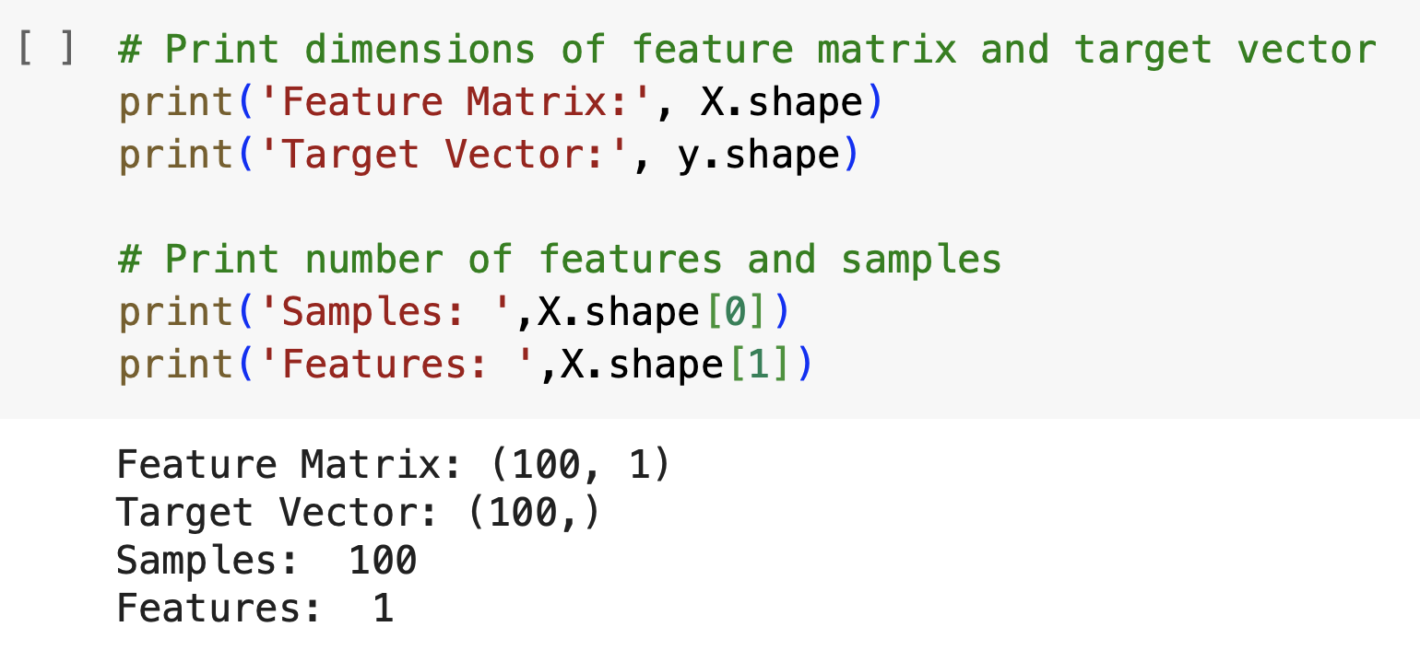
Activity 1: dimensions of the feature matrix X and target vector y.

Slide 33
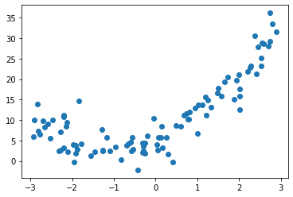
Activity 2: Plot the generated samples.
Hint: use plt.plot

Slide 34
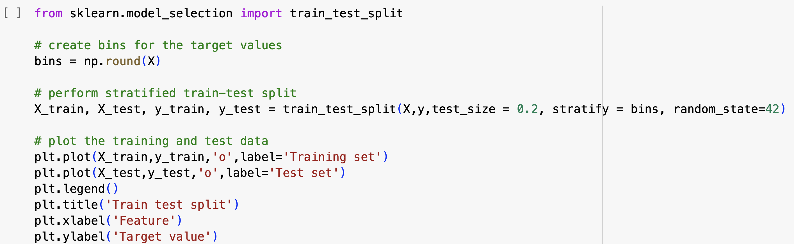
Split the data to training and test set
Scikit learn offers a function sklearn.model_selection.train_test_split to perform the splitting of the dataset. A common pattern is to keep 80% of the data for training and use 20% for testing. This can be set using an option test_size. Splitting is random, so if we wish to keep the same split at every run we can use parameter random_state.
Finally, to create a representative test set, we can use the stratify parameter. In this example we will split the data into 7 bins by rounding the feature values, and stratify the test set to have the same proportion of the data from each bin as the training set.

Slide 35
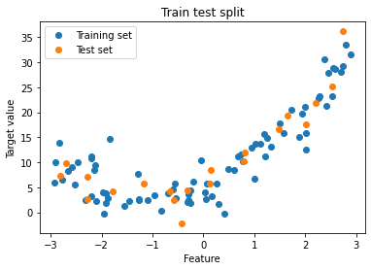
Split the data to training and test set

Slide 36
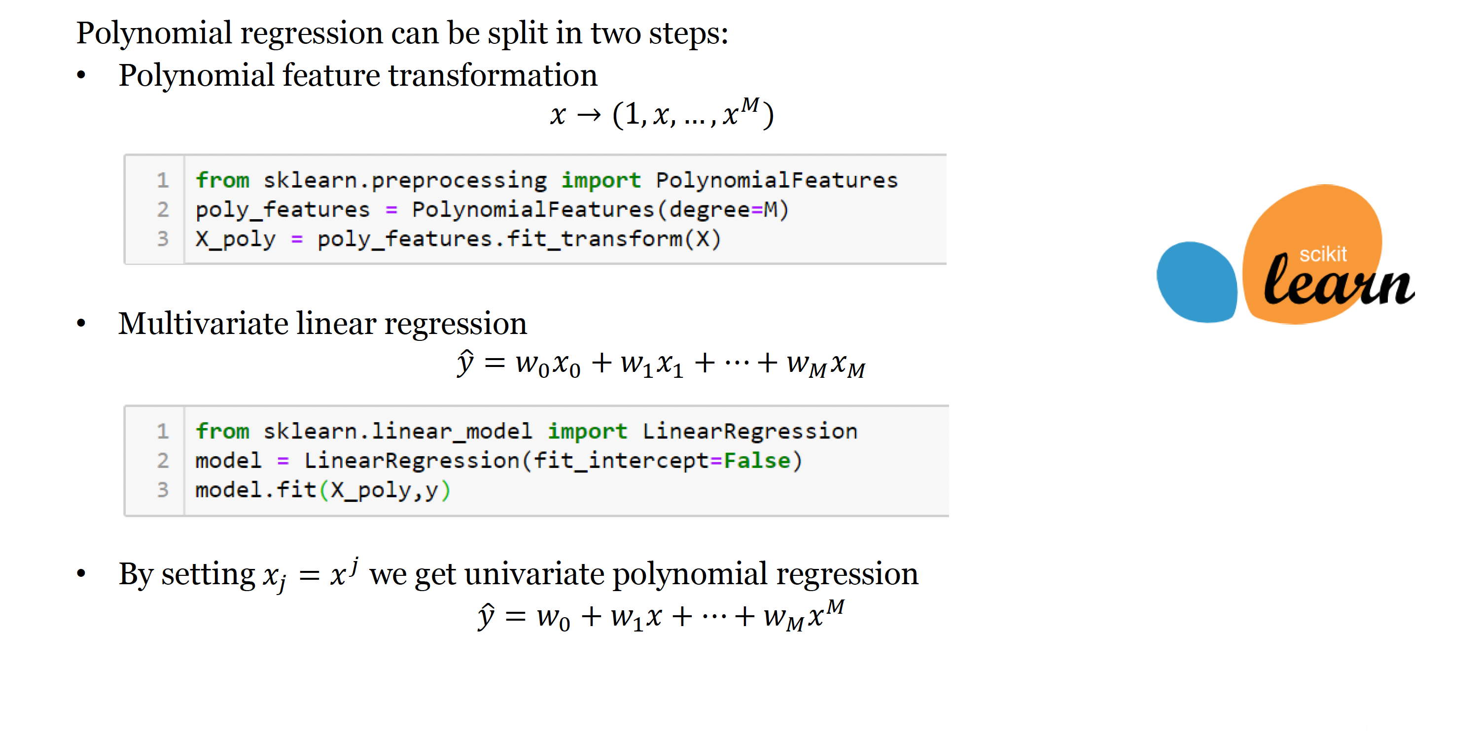
Polynomial regression in scikit-learn

Slide 37
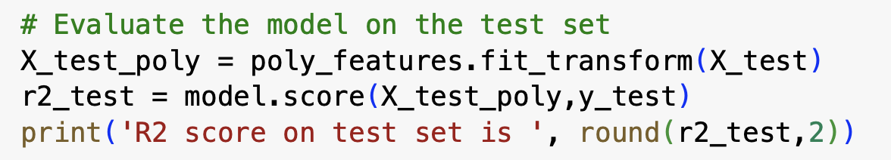
Evaluate the Model
R2 score on test set is 0.93

Slide 38
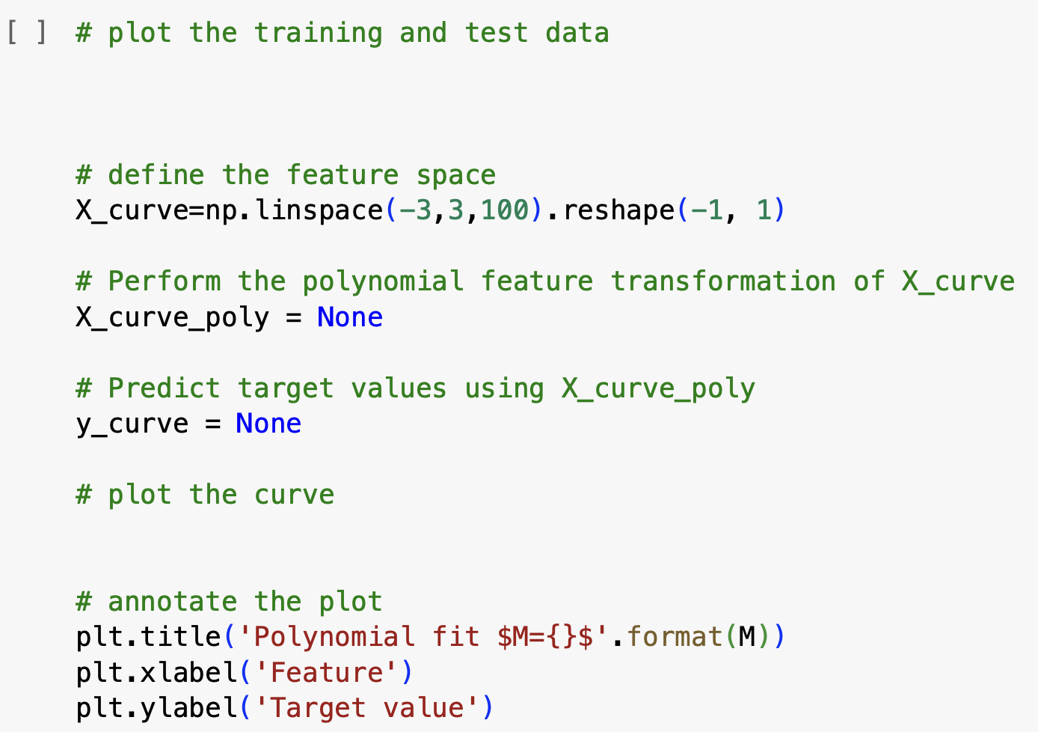

Plot the fitted polynomial model
Activity 4: Fill in the code bellow to plot the second order polynomial model that we just fitted. Then change the polynomial degree in the cell above, and rerun both cells to see how the model changes.

Slide 39
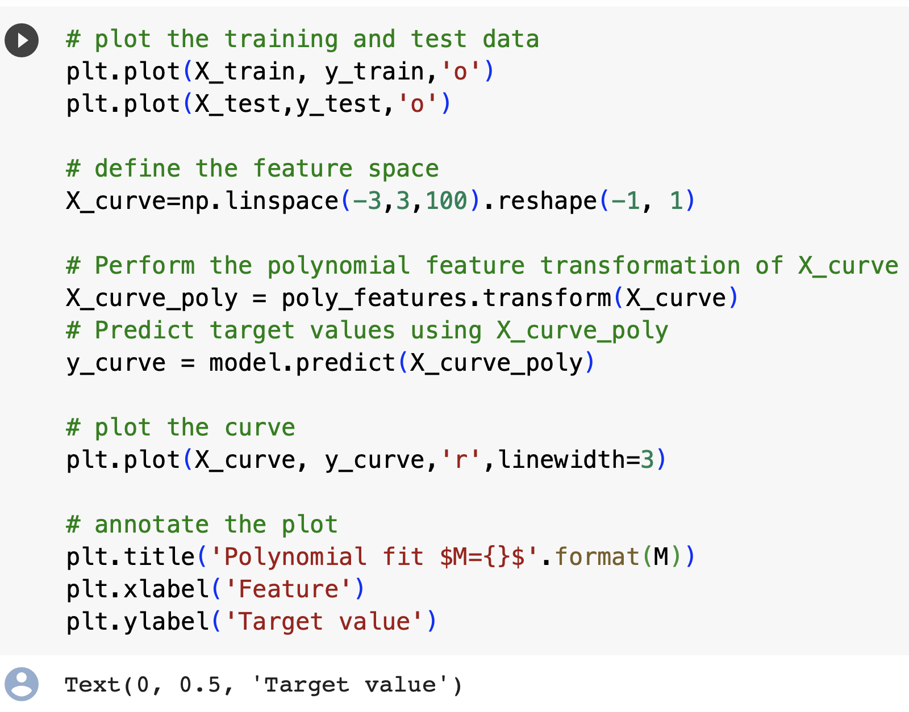
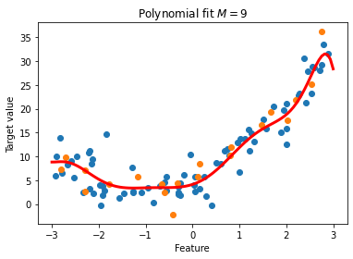

Plot the fitted polynomial model
Activity 4: Fill in the code bellow to plot the second order polynomial model that we just fitted. Then change the polynomial degree in the cell above, and rerun both cells to see how the model changes.

Slide 40
Setting up a model pipeline
It is not always convenient to perform several steps for model training, prediction and evaluation. In particular if the model becomes an input to another sklearn object, such as hyperparameter search using cross-validation that we will introduce below, the steps need to be unified in a single object.
Scikit-learn implements a class sklearn.pipeline.Pipeline to join multiple steps into one model. Pipeline implements methods fit, predict, score and others to offer a unified API with other sklearn objects.

Slide 41
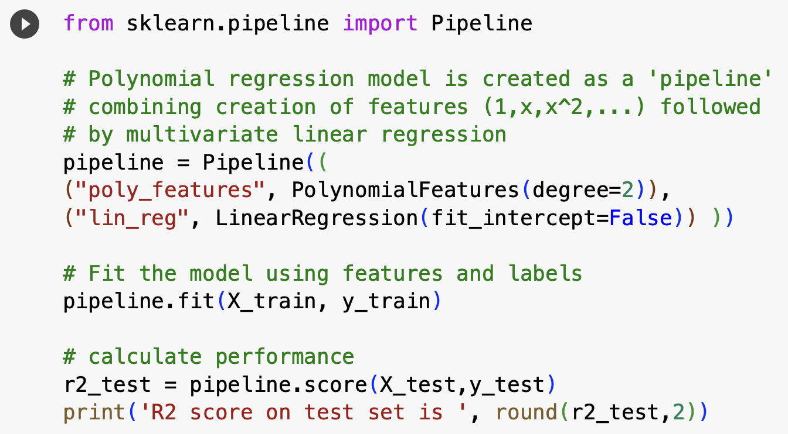
Setting up a model pipeline
It is in the form Pipeline(steps), where the input argument steps is a list of transforms and models to be chained, in the order with which they need to be called. Each step is described by a tuple (name, model), where name is a string chosen by the user and model is a sklearn object.
In the code we will demonstrate how to join the polynomial feature transformation and multivariate linear regression into a single model.
R2 score on test set is 0.91
Notes:
It is not always convenient to perform several steps for model training, prediction and evaluation. In particular if the model becomes an input to another sklearn object, such as hyperparameter search using cross-validation that we will introduce below, the steps need to be unified in a single object.
Scikit-learn implements a class sklearn.pipeline.Pipeline to join multiple steps into one model. Pipeline implements methods fit, predict, score and others to offer a unified API with other sklearn objects.
In the code bellow we will demonstrate how to join the polynomial feature transformation and multivariate linear regression into a single model.
+
Let's look in detail at the syntax for creating the pipelines. It is in the form Pipeline(steps), where the input argument steps is a list of transforms and models to be chained, in the order with which they need to be called. Each step is described by a tuple (name, model), where name is a string chosen by the user and model is a sklearn object.

Slide 42
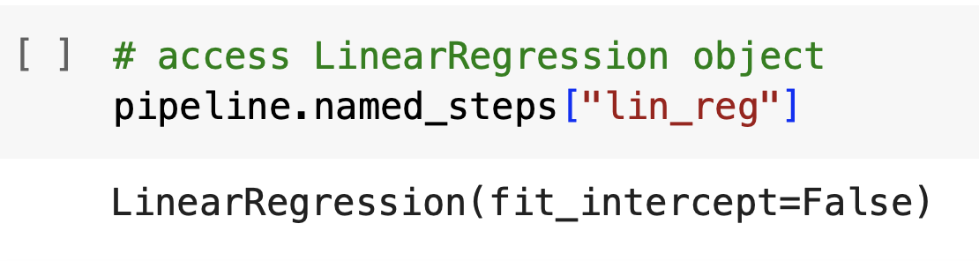
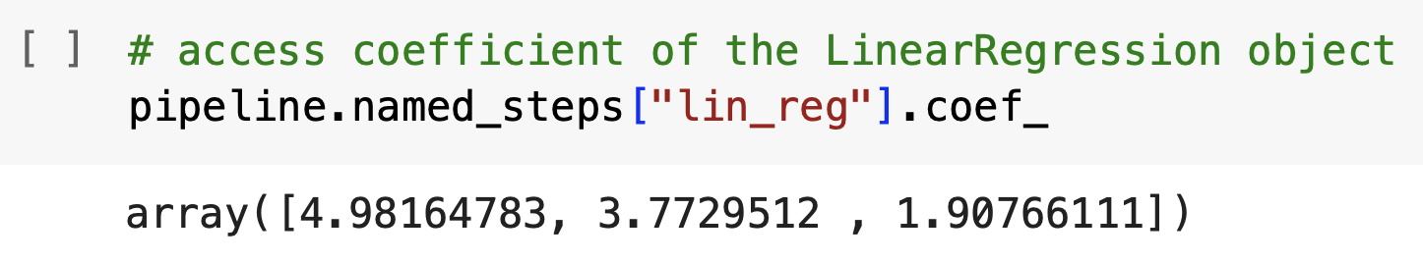
To access the original objects joint in a Pipeline
To access the original objects joint in a Pipeline we use attribute Pipeline.named_steps. For example, the linear regression object defined in the cell above can be accessed as:
and coefficient of the linear regression 𝑤0,...,𝑤𝑘 can be accessed as

Slide 43
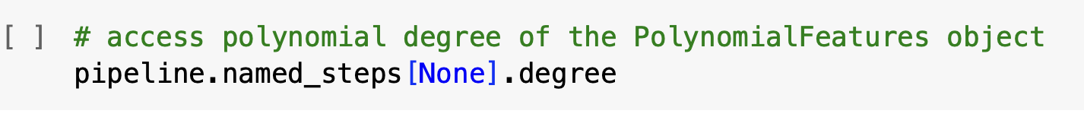
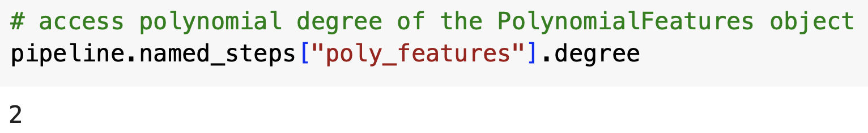
Activity 5: Complete the code bellow to print out polynomial degree
Answer

Slide 44
Cross Validation
In scikit-learn cross validation is called using cross_val_score(estimator, X, y) with arguments
estimator: the model to be fit
X: the feature matrix
y: optional target values or labels for supervised models
cv: optional argument that defines number of folds.
The model returns an array with scores from each fold.
Notes:
Even if we stratify our test set, it is not guaranteed that it is representative and the performance may vary every time we create a different split. More robust way is to perform cross-validation, where we split the data into 𝑘 groups (folds), and each fold will be used to measure performance exactly once, while remaining data are used to fit the model. Average performance over the 𝑘 folds will be much more robust. If there are no hyperparameters to tune, cross-validation can be used directly to measure the performance of the model.

Slide 45
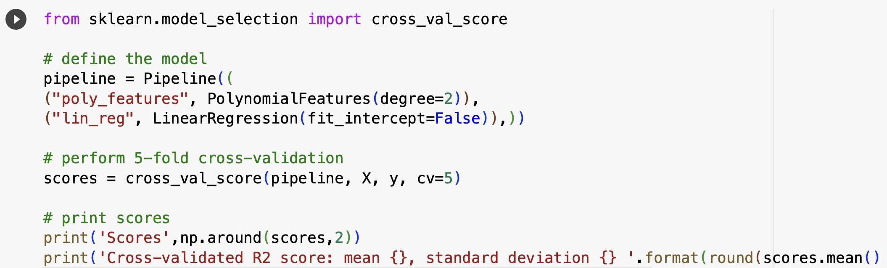
Activity 6: Cross validation in pipeline
Activity 6: Perform cross-validation for polynomial models of different degrees and observe how the average 𝑅2 score changes. To do that you can modify the polynomial degree and rerun the cell above multiple times

Slide 46
Hyperparameter search using cross-validation
Finally we will show how we can automatically find the optimal hyperparameters in scikit-learn. One of the most common way is to train a model for each hyper-parameter value and measure its performance using cross-validation.
This approach is implemented in sklearn.model_selection.GridSearchCV.
First we need to create the grid search object using GridSearchCV(estimator, param_grid) with arguments:
estimator: the model to be fitted
param_grid: a dictionary, with parameter names as keys, and parameter values as lists
cv: optional parameter to determine the number of folds
We will now find the optiomal polynomial degree automatically, using the GridSearchCV. First we need to define our parameter grid dictionary. Because we have a Pipeline object, the parameter name is combined of the step name "poly_features" and parameter name "degree" which are joined by two underscores __.

Slide 47
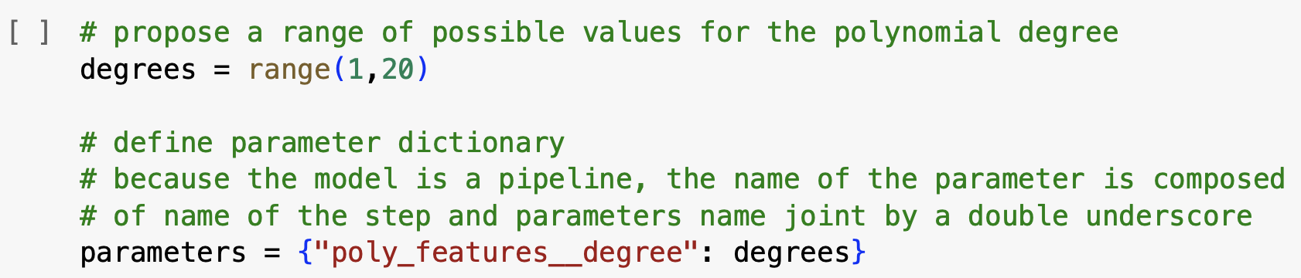
Find the optiomal polynomial degree
We will now find the optiomal polynomial degree automatically, using the GridSearchCV. First we need to define our parameter grid dictionary. Because we have a Pipeline object, the parameter name is combined of the step name "poly_features" and parameter name "degree" which are joined by two underscores __.

Slide 48

Create the GridSearchCV object
Next we create the GridSearchCV object and run the hyperparameter optimization using method fit, which is performed on the training set. The chosen polynomial model can be accessed using the variable best_estimator_
First we need to create the grid search object using GridSearchCV(estimator, param_grid) with arguments:
estimator: the model to be fitted
param_grid: a dictionary, with parameter names as keys, and parameter values as lists
cv: optional parameter to determine the number of folds

Slide 49

The best R2 score
We can also access the chosen polynomial, and the best R2 score identified through cross-validation.

Slide 50

Evaluate performance on test set
We can evaluate the performance on the test set directly using a trained GridSearchCV by calling its method score. It will return the score of the model with the best hyperparameter setting identified during the search and fitted to the whole training set.

Slide 51


Tutorial: Training machine learning models
Step 1: Split to training and test set
Step 2: Tune hyperparameters using cross-validation
Step 3: Evaluate performance on test set
Tutorial:
Jupyter Notebook :
2.6 Training models in sklearn
Detailed guidance on how to train models in sklearn
Exercise 5: Recover polynomial model

Slide 52
Tutorial: Optional resources
Learn plotting with Matplotlib
Jupyter notebook: 2.2 Matplotlib
Learn data manipulation with Pandas
Jupyter Notebook: 2.3 Pandas

